Slide 1
Combining Random Variables

Slide 2
linear combination of random variables
If X1 , X2, . . . , Xn are random variables and a1 , a2, . . . , an are numerical constants, the random variable Y defined as
Y = a1X1 + a2X2 + … + anXn is a linear combination of
X1, X2, …, Xn.

Slide 3
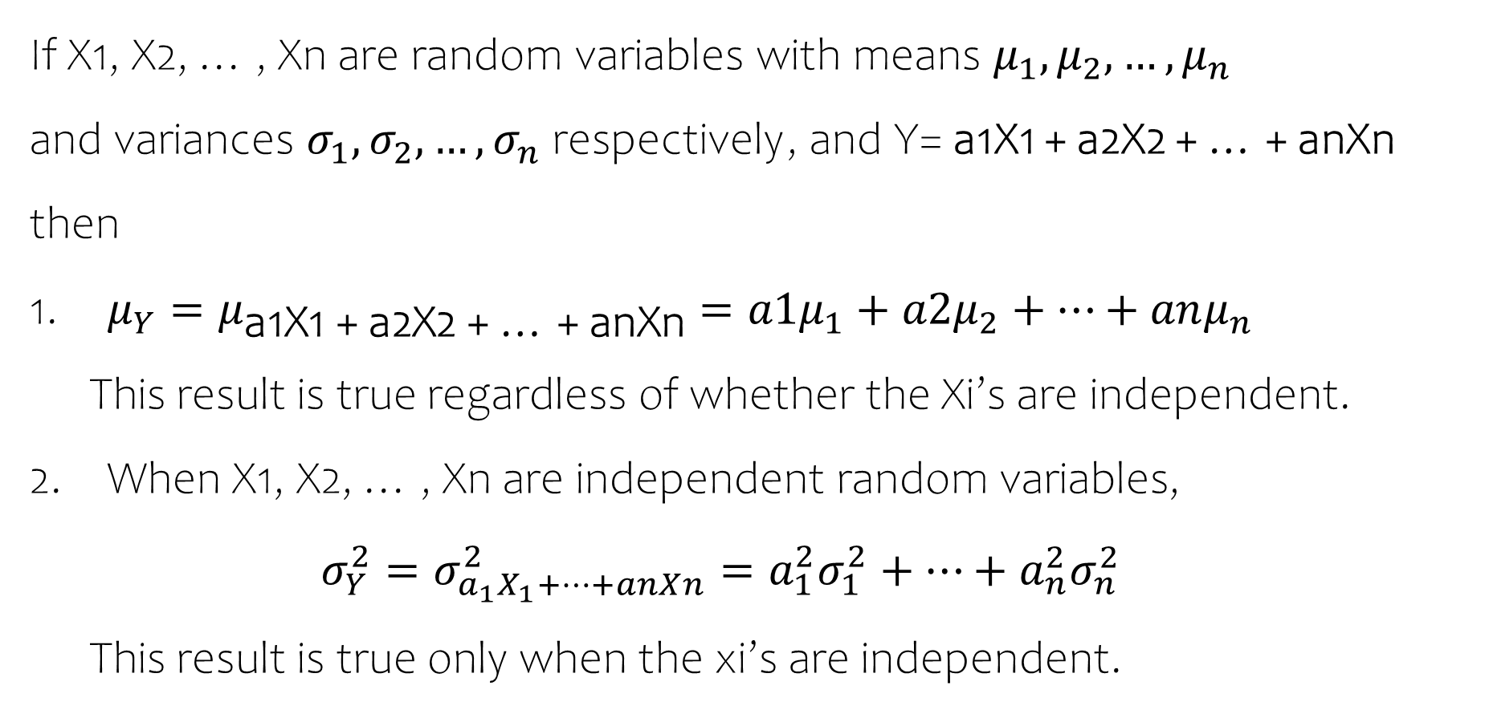
If X1, X2, … , Xn are random variables with means $μ_{1},μ_{2},…,μ_{n}$
and variances $σ_{1},σ_{2},{…,σ}_{n}$ respectively, and Y= a1X1 + a2X2 + … + anXn then
$μ_{Y}=μ_{\text{a}\text{1}\text{X}\text{1 + }\text{a}\text{2}\text{X}\text{2 + … + }\text{anXn}}=a1μ_{1}+a2μ_{2}+…+anμ_{n}$
This result is true regardless of whether the Xi’s are independent.
When X1, X2, … , Xn are independent random variables,
$$σ_{Y}^{2}=σ_{a_{1}X_{1}+…+anXn}^{2}=a_{1}^{2}σ_{1}^{2}+…+a_{n}^{2}σ_{n}^{2}$$
This result is true only when the xi’s are independent.

Slide 4
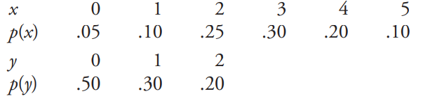
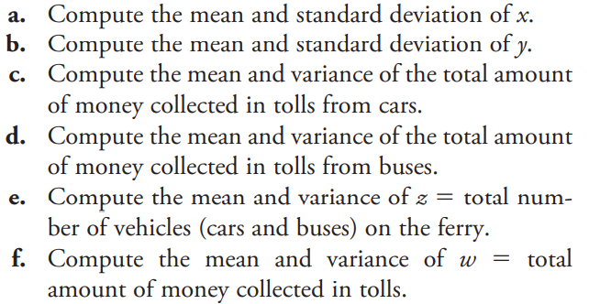
Consider a large ferry that can accommodate cars and buses. The toll for cars is $3, and the toll for buses is $10. Let x and y denote the number of cars and buses, respectively, carried on a single trip. Cars and buses are accommodated on different levels of the ferry, so the number of buses accommodated on any trip is independent of the number of cars on the trip. Suppose that x and y have the following probability distributions:

Slide 5

E(X) = 2.8 cars $σ_{X}=$1.288 cars
E(Y) = 0.7 buses$σ_{Y}=$ 0.781 buses
E(3X) = 3 E(X) = $ 8.4
$σ_{3X}=3σ_{X}$ = $3.864
Var(3X) = 14.94
E(10Y) = 10E(Y) = $7
Var(10Y) = 100 * 0.781 * 0.781 = 61
E(Z) = E(X+Y) = E(X)+E(Y) = 3.5 vehicles
Since X and Y are independent,
Var(Z) = Var(X+Y) = Var(X) + Var(Y) = 1.288 * 1.288 + 0.781 * 0.781 = 2.27
W = 3X+10Y
E(W) = 3 E(X) + 10 E(Y) = $ 15.4
Var(W) = Var(3X+10Y) = Var(3X) + Var(10Y) = 14.94+61 = 75.94

